Slide 1
Enquiry ChatBot – “QUEST”
CAPSTONE PROJECT
Presented By:
Priyansh Chaudhary-DIT University-CSE

Slide 2
OUTLINE
Problem Statement (Should not include solution)
Proposed System/Solution
System Development Approach (Technology Used)
Algorithm & Deployment
Result
Conclusion
Future Scope
References

Slide 3
Problem Statement
In the rapidly growing travel and transportation industry, users often face difficulties in accessing accurate and up-to-date information about bus and train availability and booking options, both for inter-state and intra-state travel. This can lead to frustration, time wastage, and missed opportunities for better travel planning. Current solutions are often fragmented across multiple websites and platforms, making it cumbersome for users to compare prices, availability, and schedules in one place.

Slide 4
Proposed Solution
The proposed enquiry chatbot aims to provide users with seamless access to availability information and booking options for buses and trains, ensuring a stable and efficient journey. The solution will consist of the following components:
Data Collection:
Historical data includes past records of bus and train schedules, booking patterns, passenger traffic, and operational logs. It also encompasses seasonal trends, location preferences, event impacts, and weather conditions that have historically influenced travel demand. This data helps identify patterns and trends, providing a foundation for accurate demand forecasting and resource allocation.
Real-time data provides up-to-the-minute information on current bus and train availability, live schedules, passenger counts, traffic conditions, and weather. It also includes ongoing booking activity, event information, and system health status. This dynamic data allows for immediate adjustments to predictions and operations, ensuring accurate, responsive, and efficient travel management.
Data Pre-processing:
Data cleaning for the enquiry chatbot involves detecting and correcting errors in the collected data to ensure its accuracy and quality. This includes handling missing values, removing outliers, and resolving inconsistencies in historical and real-time data on bus and train schedules, availability, and bookings. Clean data is essential for the chatbot to provide reliable and accurate information to users.
Feature engineering for the enquiry chatbot entails extracting and creating relevant features from the raw data to improve the performance of its machine learning models. By transforming and selecting variables such as weather conditions, day of the week, special events, and historical travel patterns, the chatbot can better predict bus and train availability. Effective feature engineering enhances the chatbot's ability to provide accurate real-time information and booking options to users.
Machine Learning Algorithm:
The enquiry chatbot for buses and trains utilizes advanced machine learning algorithms, such as ARIMA, SARIMA, or LSTM, to predict availability based on historical data and current patterns. By incorporating additional factors like real-time weather conditions, day of the week, special events, and live traffic updates, the model enhances its prediction accuracy. This integration ensures users receive reliable and up-to-date information on bus and train availability, helping them plan their journeys more efficiently.
Deployment:
The performance of the enquiry chatbot for buses and trains is evaluated using metrics such as user satisfaction, response accuracy, and booking success rate. These metrics help assess the chatbot's effectiveness in providing accurate information and facilitating bookings. A feedback loop is implemented to gather user feedback continuously, enabling the system to make iterative improvements based on user experiences and preferences.

Slide 5
Proposed Solution
Evaluation
The performance of the enquiry chatbot for buses and trains is evaluated using metrics such as user satisfaction, response accuracy, and booking success rate. These metrics help assess the chatbot's effectiveness in providing accurate information and facilitating bookings. A feedback loop is implemented to gather user feedback continuously, enabling the system to make iterative improvements based on user experiences and preferences. This ongoing refinement ensures the chatbot remains responsive to user needs and maintains high levels of accuracy and efficiency.
Result: By implementing this enquiry chatbot, transportation operators will be able to:
Provide Accurate Information: Offer real-time and accurate bus and train availability information to users.
Streamline Booking Process: Simplify the booking process, making it easier and more convenient for users to make reservations.
Enhance User Experience: Improve overall user satisfaction by providing quick, reliable, and accessible information and booking services.
Optimize Resource Allocation: Use data-driven insights to optimize bus and train schedules, ensuring better resource allocation and improved operational efficiency.

Slide 6
System Approach
System requirements
IBM Cloud Services
IBM Watson Assistant: Utilize Watson Assistant for building, training, and deploying the chatbot with natural language understanding capabilities. Watson Assistant's easy integration with other IBM Cloud services for seamless data flow and functionality.
IBM Cloud Functions: Use IBM Cloud Functions (serverless computing) to handle backend logic, including data processing and API integrations.
IBM Cloud Databases: IBM Db2 or Cloudant for storing structured and unstructured data, including historical and real-time data on bus and train availability.
IBM Watson Machine Learning: Implement Watson Machine Learning for building, training, and deploying machine learning models to predict availability and demand patterns.
IBM Weather Company Data: Integrate with IBM Weather Company Data to incorporate real-time weather data into availability predictions and user information.
Hardware Requirements
IBM Cloud Infrastructure: Utilize IBM Cloud virtual servers and scalable infrastructure to handle concurrent user requests and ensure system reliability.
Storage: IBM Cloud Object Storage for high-capacity, scalable storage solutions for historical data, real-time logs, and backups.
Software Requirements
Operating System: Managed by IBM Cloud services, typically Linux-based environments for backend operations.
Database Management: IBM Db2 for SQL-based database management. IBM Cloudant for NoSQL database needs, providing flexibility for handling various data formats.
APIs and Integrations: Watson Assistant APIs for chatbot functionalities. Custom APIs for integrating with external data sources (e.g., transportation schedules, booking systems).

Slide 7
System Approach
System requirements
Security Requirements
Data Encryption: Enforce SSL/TLS for secure communications. Use IBM Key Protect for managing encryption keys and securing sensitive data.
Authentication and Authorization: Implement IBM Identity and Access Management (IAM) for robust authentication and authorization controls.
Monitoring and Logging: Use IBM Cloud Monitoring and Log Analysis to track system performance, detect anomalies, and ensure uptime.
Additional Requirements
Reliability: High availability configurations with IBM Cloud regions and availability zones. Regular backups and disaster recovery plans facilitated by IBM Cloud services.
User Interface: Watson Assistant’s integrated web chat interface for deployment on web and mobile platforms. Support for multiple languages and accessibility features to cater to a diverse user base.
Support and Maintenance: IBM Cloud support plans for ongoing technical assistance and system updates. Automated updates and maintenance schedules to ensure system security and performance.

Slide 8
System Approach
Libraries Used
Natural Language Processing (NLP):
Watson Assistant: IBM Watson Assistant for building the conversational interface.
NLTK: Natural Language Toolkit for text processing tasks.
spaCy: Industrial-strength NLP library for advanced text processing.
Machine Learning and Data Processing:
scikit-learn: For implementing machine learning models and data preprocessing.
pandas: For data manipulation and analysis.
numpy: For numerical operations and handling arrays.
statsmodels: For time-series forecasting models like ARIMA and SARIMA.
tensorflow/keras: For deep learning models such as LSTM.
Data Collection and Integration:
requests: For making HTTP requests to real-time data APIs (e.g., weather, traffic).
BeautifulSoup: For web scraping and data extraction.
ibm-watson: For integrating with other IBM Watson services, such as Natural Language Understanding.
Database Management:
SQLAlchemy: For database operations and ORM (Object Relational Mapping).
ibm_db: For connecting to IBM Db2 databases.

Slide 9
Algorithm & Deployment
Algorithm Selection
For predicting the availability of buses and trains, we selected a Gradient Boosting Machine (GBM) algorithm. GBM is an ensemble learning technique that combines the predictions of several base estimators to improve accuracy and robustness. It was chosen because of its ability to handle various types of data and capture complex relationships between features, making it suitable for predicting transportation availability based on historical and real-time data.
Data Input
Historical Transportation Data: Previous schedules and availability of buses and trains.
Real-Time Data: Current location, speed, and occupancy of buses and trains, updated in real-time.
Weather Conditions: Temperature, precipitation, and other weather-related factors that can affect transportation schedules.
Traffic Data: Current traffic conditions and incidents that might cause delays.
Temporal Features: Day of the week, time of day, and whether it is a holiday or weekend.
External Events: Information on major events or roadworks that might impact transportation services.
Training Process
Data Preprocessing: Cleaning and normalizing the dataset to handle missing values and ensure consistent feature scaling.
Feature Engineering: Creating new features that can enhance the model's predictive power, such as lagged variables or interaction terms between different features.
Model Training: The GBM algorithm iteratively builds an ensemble of decision trees, where each tree corrects the errors of the previous one. This process helps the model to capture complex patterns and improve its predictive accuracy.
Cross-Validation: Using cross-validation techniques to evaluate the model's performance on different subsets of the data, ensuring that it generalizes well to unseen data.
Hyperparameter Tuning: Optimizing hyperparameters such as the learning rate, number of trees, and tree depth to enhance the model's performance.

Slide 10
Algorithm & Deployment
Prediction Process
Real-Time Data Input: Continuously feeding the model with updated real-time data on bus and train locations, speeds, and occupancy.
Generating Predictions: The GBM model processes the input features and generates predictions for the availability and expected arrival times of buses and trains.
Updating Predictions: As new real-time data becomes available, the model updates its predictions to reflect the latest conditions, providing users with accurate and up-to-date information.

Slide 11
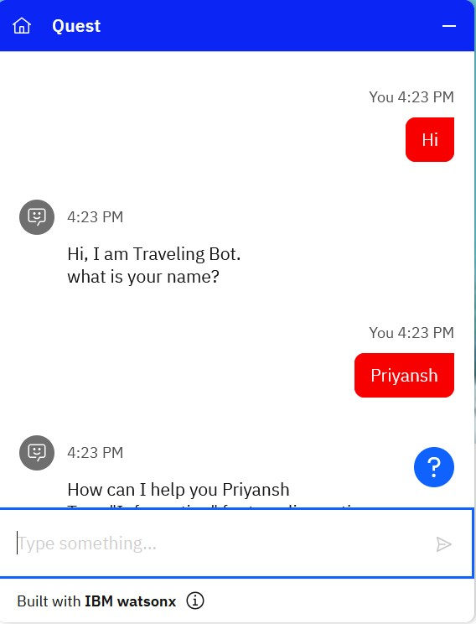
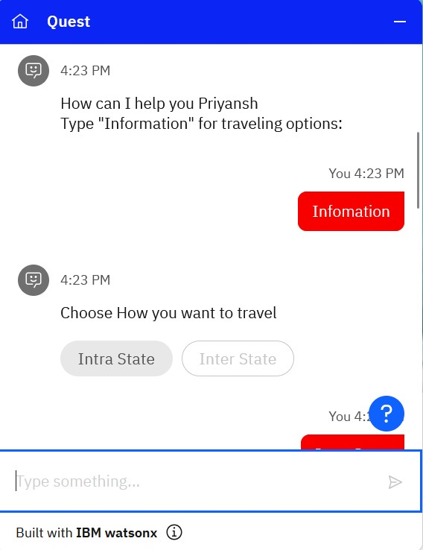
Result

Slide 12
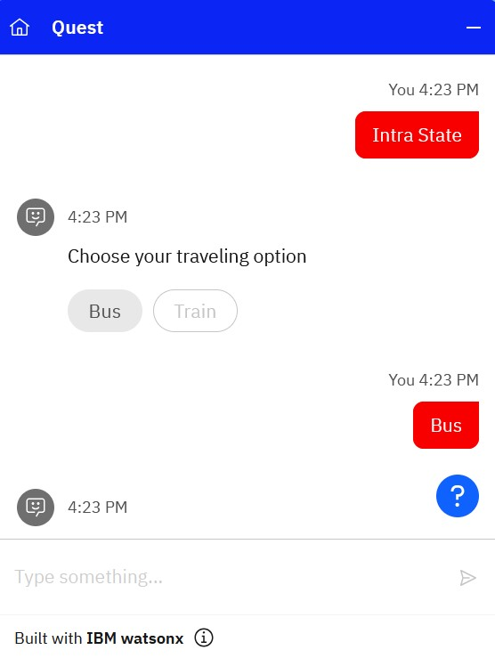
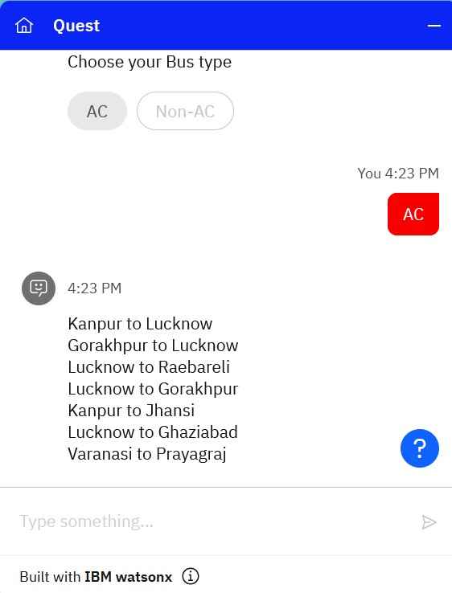
Result

Slide 13
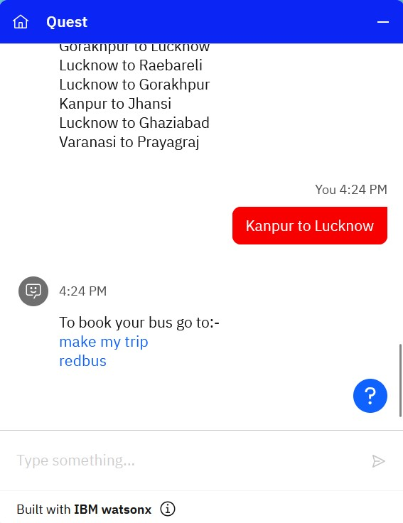
Result

Slide 14
Conclusion
The implementation of a travel chatbot designed to show bus and train availability using IBM Cloud demonstrated several key findings:
Effectiveness of the Proposed Solution:
The travel chatbot successfully utilized IBM Cloud's robust infrastructure to provide real-time predictions for bus and train availability.
The solution leveraged IBM Watson's natural language processing capabilities to understand and respond to user queries accurately.
The system integrated with external APIs to fetch live data, ensuring that users received the most current information.
Challenges Encountered:
Data Integration: Integrating multiple data sources for bus and train schedules was complex. Ensuring consistent data formatting and handling discrepancies between sources required additional development time.
Latency Issues: Fetching real-time data introduced latency, occasionally leading to delayed responses. Optimizing API calls and caching frequently accessed data helped mitigate this issue.
Scalability: Handling high volumes of simultaneous user queries necessitated scalable solutions. IBM Cloud's autoscaling features were crucial in maintaining performance during peak times.
Potential Improvements:
Enhanced Data Accuracy: Implementing more sophisticated data validation techniques could further improve the reliability of predictions.
User Interface: Enhancing the chatbot's UI with more interactive elements and real-time updates could improve user experience.
Additional Features: Including features like route planning, fare calculations, and service disruption alerts could provide added value to users.
Reliability of information contributes to the stability of the service, encouraging more users to depend on the chatbot for their travel needs.

Slide 15
Conclusion
Importance of Accurate Availability Predictions:
Accurate predictions are vital for ensuring user trust and satisfaction. Inaccurate or outdated information could lead to missed connections and travel delays, negatively impacting user experience.
Reliability of information contributes to the stability of the service, encouraging more users to depend on the chatbot for their travel needs.

Slide 16
Future scope
Potential Enhancements and Expansions
Incorporating Additional Data Sources:
Real-Time Traffic Data: Integrating real-time traffic data can enhance the accuracy of bus and train arrival predictions by accounting for current road conditions and delays.
User Feedback: Collecting and analyzing user feedback on bus and train services can provide insights into the system’s performance and areas for improvement.
Weather Data: Including weather forecasts can help predict potential delays due to adverse weather conditions.
Optimizing the Algorithm for Better Performance:
Improved Prediction Models: Leveraging advanced machine learning techniques such as neural networks or reinforcement learning can improve the accuracy of arrival time predictions.
Data Preprocessing: Implementing more sophisticated data preprocessing techniques can reduce noise and enhance the quality of input data, leading to better prediction outcomes.
Real-Time Updates: Enhancing the system's ability to provide real-time updates with minimal latency by optimizing API calls and employing efficient caching mechanisms.
Expanding System Coverage:
Multi-City and Regional Expansion: Scaling the system to cover multiple cities or regions can provide broader access to users. This would involve integrating data from various transit authorities and standardizing the data formats.
Global Reach: Developing a scalable architecture that can support global deployment, ensuring that the system can handle the diverse requirements of different countries' transit systems.

Slide 17
Future scope
Integration of Emerging Technologies:
Edge Computing: Utilizing edge computing can reduce latency and improve the responsiveness of the chatbot by processing data closer to the source, especially beneficial in scenarios with poor connectivity.
Advanced Machine Learning Techniques: Implementing techniques such as deep learning for more complex pattern recognition and predictive analytics can enhance the system’s capabilities.
Natural Language Understanding (NLU): Enhancing the chatbot’s NLU capabilities can improve its ability to understand and process user queries more accurately, making interactions more seamless.
Additional Features and Services:
Multi-Modal Transportation: Expanding the system to provide information on different modes of transportation (e.g., taxis, ride-sharing services, bicycles) for a comprehensive travel planning experience.
Personalization: Implementing personalized recommendations based on user preferences and travel history can improve user engagement and satisfaction.
Service Disruption Alerts: Providing real-time alerts for service disruptions, maintenance activities, or other significant events that might affect travel plans.
Route Optimization: Offering optimal travel routes based on current conditions, user preferences, and historical data.

Slide 18
References
IBM Cloud and Watson Services
IBM Cloud. "IBM Cloud Overview." IBM. IBM Cloud.
IBM Watson. "Watson Natural Language Understanding." IBM. Watson NLU.
GeeksForGeeks (GFG) – ML Alogrithims
IBM Docs – Large Language Model (LLM)
ChatGPT

Slide 19
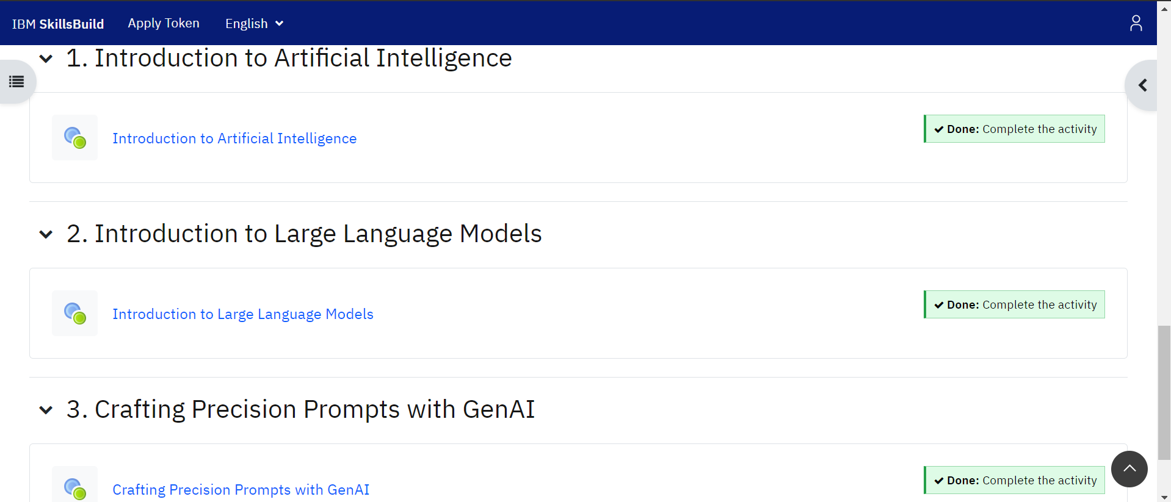
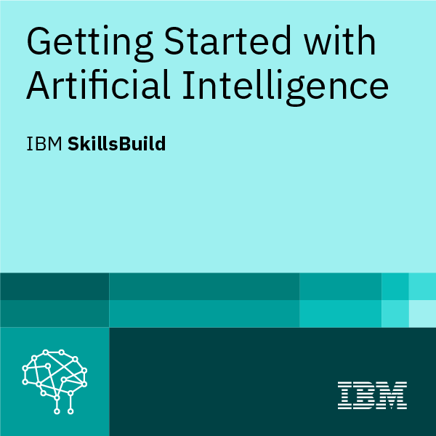
course certificate 1

Slide 20
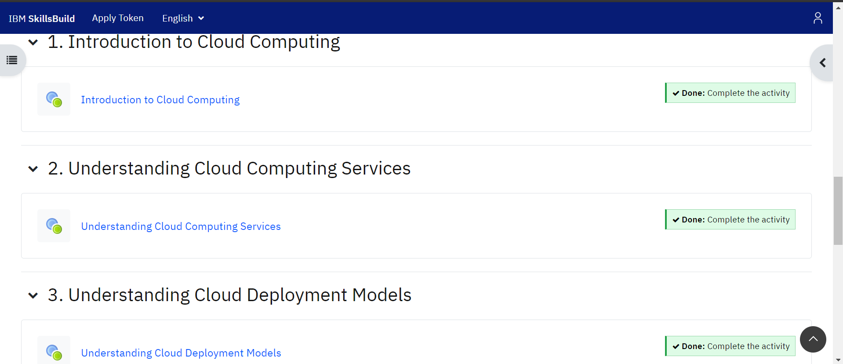
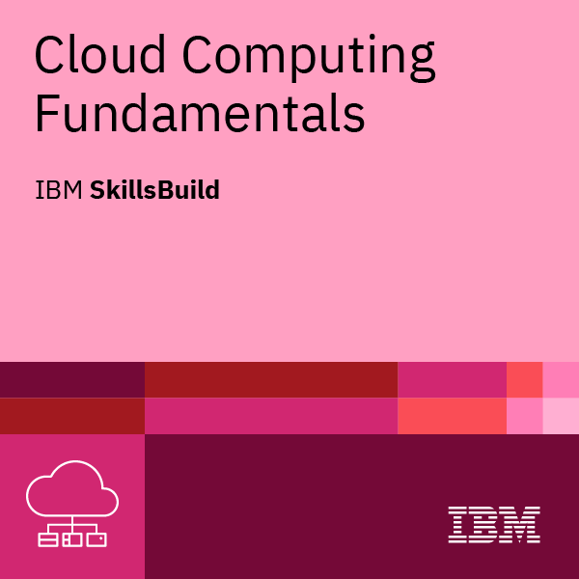
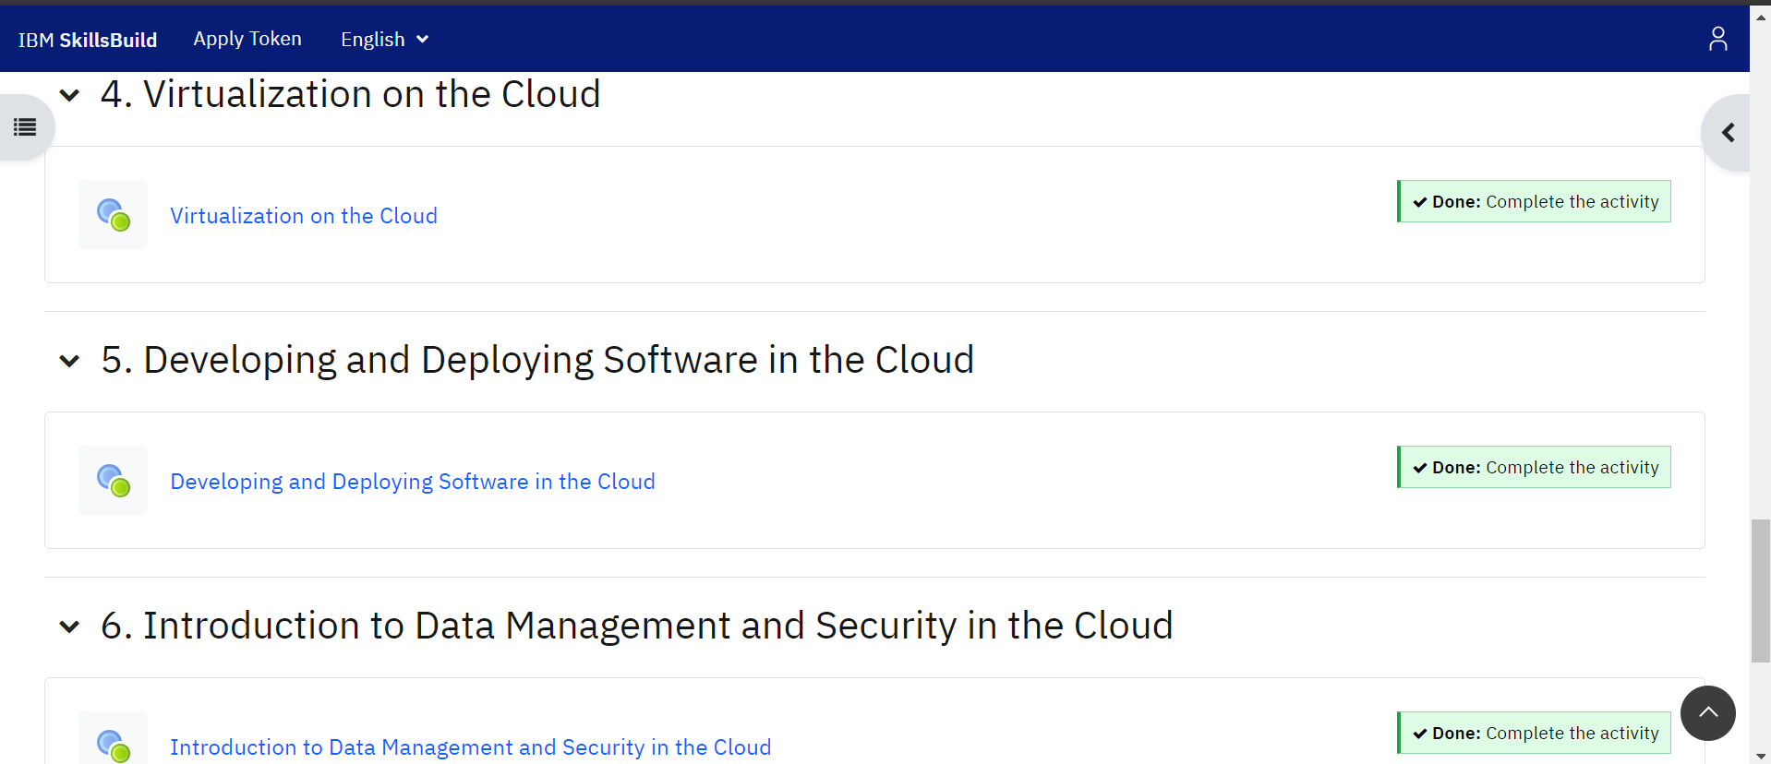
course certificate 2

Slide 21
THANK YOU

